Slide 1
K-means clustering:
It is unsupervised ML algorithm that partitions data into K-distinct clusters based on similarity. Each cluster is represented by its centroid ( mean of points in the cluster) and data points are assigned to the cluster with nearest centroid.

Slide 2
Working Steps:
Step 1: Initialize Centroids
Randomly select K initial centroids (cluster centers), where K is the predefined number of clusters.
Step 2: Assign Data Points to Clusters
Calculate the distance (e.g., Euclidean distance) between each data point and all centroids.
Assign the data point to the nearest centroid.
Step 3: Recalculate Centroids
Compute the new centroid of each cluster as the mean of all data points assigned to it

Slide 3
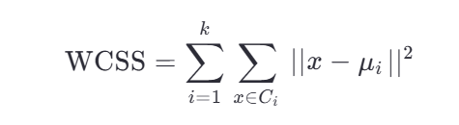
.
Step 4: Repeat Steps 2–3
Reassign data points to the updated centroids and recalculate centroids iteratively until:
1. Centroids no longer change significantly (convergence).
2. A maximum number of iterations is reached.

Slide 4
K-means clustering:
Advantages:
1.Easy to implement
2.Relatively fast and effiecient
3.We just have to tune one parameter that is “k” and we can see the result.
Disadvantages:
1.Sensitive to outliers. Distance
2.We should know the number of clusters clusters “k” value in advance.
3.Problem with categorical values.
4.Scaling is required

Slide 5
.
Applications:
1. In market to find customers that are similar to each other in terms of attribute.
2.segregate images, image impression.
3.document clustering based on various topics, tags, content.
4. Insurance fraud detection.

Slide 6



